Slide 1
Legislative Update on Military and Veterans Benefits
Paul Frost, AFC®
CAPT, USN (Ret)
Program Director, Finance and Benefits Information
MOAA Transition Center

Slide 2
MOAA = Advocacy
When earned pay and benefits are threatened, MOAA stands ready to protect and defend all of the uniformed services present, past and future.
Military Compensation
Concurrent Receipt
SBP/DIC
TRICARE fees
Veteran Healthcare

Slide 3
Never Stop Serving
MOAA operates two charity subsidiaries to help military and veteran families enjoy a quality of life they have earned through their service.
Career Transition
Military Spouse Professional Development
Professional Education Outreach
Community Outreach & Emergency Relief
100% of your donation goes to a student
$160M to 16,000 students
2021-2022: 1,100+ students awarded $8M
Active duty
Reserve & National Guard
Retirees
Veterans
Military Spouses & Families
Extended Military Community
To learn more and to join the efforts, visit www.moaa.org/donate

Slide 4
To All of You Who…
are wearing the uniform…
have worn the uniform…
supported your Service member…
THANK YOU!

Slide 5
The Military Coalition
AAAA
AFA
AFSA
AMSUS
AMVETS
AUSA
AUSN
BVA
COA
CWOA
EANGUS
FRA
GSW
IAVA
JWV
MCA
MCL
MCRA
MOAA
MOPH
NERA
NCOA
NGAUS
NMFA
ROA
SWAN
TAPS
TIF
TREA
USAWOA
USCGPOA
VFW
VVA
VETS FIRST
WWP
35 Organizations—5.5 million strong
Source: The Military Coalition

Slide 6
The Legislative
Big Picture

Slide 7
Where the Fed Money Goes
Mandatory Spending
30%
Discretionary Spending
Now
Discretionary Spending
70%
29%
Mandatory Spending
1966
71%
“Discretionary spending now makes up only about a third of the federal budget, with the remaining two-thirds coming from entitlement programs and other "mandatory" spending, according to figures from the House Budget Committee. And it wasn't always so. In 1966, those ratios were almost precisely reversed, with entitlement money making up just a third of the budget, committee figures show.” Congressional Quarterly 5Feb16 “Evading the Elephant” Numbers from OMB, @Federal-Budget.insidegov.com and Congressional Research Service, “Mandatory Spending Since 1962.” March 2015.

Slide 8
Mandatory Spending
Interest
Medicare
Social
Security

Slide 9
Discretionary Budget
DOD
VA
Misc
Agri
Trans
Sci
Labor

Slide 10
The Political Environment
Trillions spent for virus issues and economy
Virus management
Unemployment
Restarting the economy
Police reforms
Social unrest

Slide 11
DoD Environment
Flat DoD budgets in the future will require tough prioritization (Year-long CR is a threat)
Pivot from Contingency Operations to near peer threat requires significant modernization and funding
Planned cuts to Military Health System difficult to reconcile with COVID lessons learned
Congress desires to reduce entitlement costs
Sexual assault and privatized housing scandals
Suicide rates are moving in the wrong direction
Each fiscal year, for the last 20 years, has started either under a CR or a government shutdown

Slide 12
Military Experience in Congress
The 117th Congress is at 17% (91 elected officials) with military experience.
Sources: Military Times, Pew, and HillVets
Notes:
CQ NEWS Nov. 11, 2020 Next Congress will have fewer veterans, but they could wield power
Nov. 11, 2020 – 5:05 p.m. By Mark Satter, CQ
Come January, fewer lawmakers on Capitol Hill will have served in the military than in previous cycles, continuing a trend that is decades in the making. --The coming Congress will include at least 80 veteran lawmakers in total, 15 of whom will be newcomers.
The figures are the latest in a trend of dwindling lawmakers with military experience, as the proportion of veterans in Congress has steadily declined for decades.--Today, about 15 percent of lawmakers have served in the military.
https://www.militarytimes.com/news/pentagon-congress/2018/11/21/veterans-in-the-116th-congress-by-the-numbers/
https://www.pewresearch.org/fact-tank/2019/02/15/the-changing-face-of-congress/
116th Congress: Senate – 19%, House – 18%
https://www.militarytimes.com/news/pentagon-congress/2019/01/10/veterans-welcome-less-than-2-percent-of-capitol-hill-staffers-have-military-experience/
https://taskandpurpose.com/vets-are-an-extreme-minority-where-theyre-needed-most-in-congressional-offices
Create graphic
1.6% of Staffers have military experience

Slide 13
DOD Personnel-Health Care Expense
Concurrent Receipt, ECI+ raises, TFL, BAH, end strength, etc.
Reflects avg. 7.1% growth from 2000 - 2011
Outlays in $ Billions
Source: NDAAs
Notes:
The media stories relate how costs have skyrocketed in the early 2000s. Sure they’ve skyrocketed if you start the clock in year 2000.
The truth is this growth was required to fix the declines to pay and benefits we experienced in the 1990s. These 1990 fixes were to bring us up to legal standards and intents.
The extra expense was Especially required as we continue the years of war after 9-11 given the manpower requirements and all volunteer force considerations.
Necessary growth between 2000 and 2011
wars
Pay raises in excess of ECI to reach the pay standard intended by law
Bring housing allowances back to competitive levels
End strength increases
Concurrent receipt
Tricare for life
Since 2011 growth has not just slowed but actually declined. Yet calls for more cuts continue.

Slide 14
Personnel Costs as % of DoD Budget
33%
Health Care Personnel
For decades, on average, less than one-third of the defense budget (under subtotal of “DoD-Military”) went to military personnel and health care costs. Sources:
Table 3.2 Outlays by Function: https://www.whitehouse.gov/omb/historical-tables/
Table 15.1 Total Outlays for Health Programs – same link as above

Slide 15
FY 2022/2023
Legislative Priorities

Slide 16
MOAA’s 2022/23 Priorities
Sustain pay raises, adequate BAH for troops / COLA for retirees
Ensure CG/USPHS/NOAA continue getting paid during shutdowns
Protect value of military health benefit
Protect Military Health System pharmacy benefit, and achieve flexibility in TRICARE pharmacy co-pays
Address barriers to accessing care within MHS, including TRICARE coverage gaps and mental health access challenges
Protect family support programs, and ensure military-provided services (housing, PCS, childcare, youth programs, financial counseling) are readily available and meet standards for quality and costs
Achieve equity of benefits, protections and administrative support for Guard/Reserve members consistent with their AD counterparts

Slide 17
MOAA’s 2022/23 Priorities
Sustain Veterans Health Administration (VHA) foundational missions and services
Reform the presumptive claim process to support veterans claiming service-connected conditions for toxic exposures
Achieve concurrent receipt of service-earned retirement pay and VA disability compensation.
Protect full military honors and burial at Arlington National Cemetery for those currently eligible
Improve survivor benefits
Support a quality transition experience from AD to veteran status for all servicemembers
Recognize the pandemic continues to affect the lives of our servicemembers and their families

Slide 18
Advocacy in Action Campaign
Each Spring, MOAA Councils and Chapters, with support from the National Headquarters, bring 3 specific, high priority legislative actions to every member of Congress
This year’s campaign focused on:
Support the Major Richard Star Act (concurrent receipt for combat-injured servicemembers) H.R. 1282 & S. 344
Reduce TRICARE Mental Health Copayments H.R. 4824
Enact a 4.6% Military Pay Raise in the FY 2023 National Defense Authorization Act (NDAA)

Slide 19
Military Pay Steady but Behind
2023 NDAA (draft) – 4.6%
0% Base line is Employment Cost Index by Bureau of Labor Statistics
Notes:
This indicates the level of currently serving pay in relation to the Employment Cost Index. The 0-line at the top is the Employment Cost Index—where currently serving pay is intended to be.
We fixed the problems in early the 2000’s with the pay increases shown in the last slide. For 3 years, we were fixed.
With the last several years of decreased raises, we are falling behind again.
The 2.4% pay increase in 2018 slowed the bleeding but you see where we show the issue we are trying to stop. We got things fixed in 2011-2013 and now the last several years of decreased raises has us falling behind again.
2018 needed the 2.4% increase to stay steady state. We need 2.9% to catch up with eci. Dod and Senate Proposed 2.1% but after conference the 2.4% was agreed to and signed by the president.
It seems we continue to ride the pendulum

Slide 20
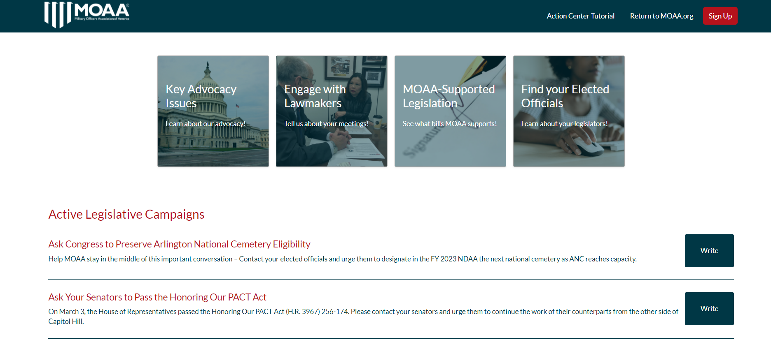
MOAA’s Legislative Action Center

Slide 21
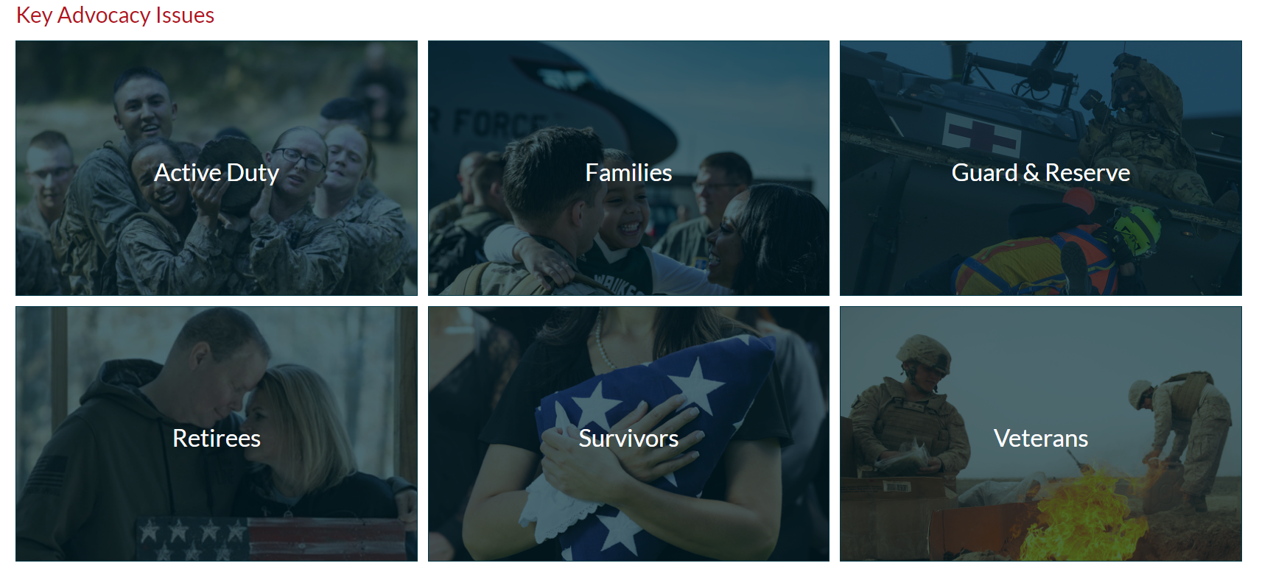
MOAA’s Legislative Action Center

Slide 22
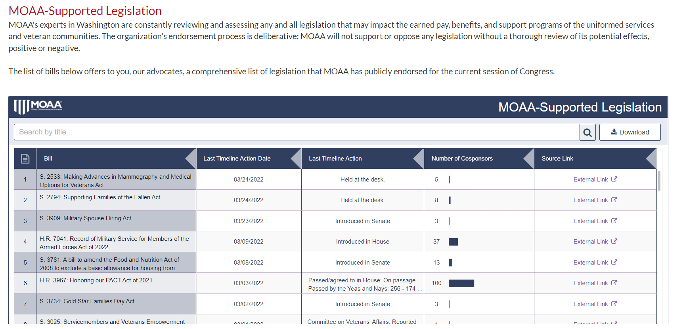
MOAA’s Legislative Action Center

Slide 23
Review Recent
Developments/Changes
Notes:
Specific topics cherry picked from the FY 2017 NDAA.
The main issue is what has been passed and changed for 2017. some changes impact your audience.
These are topics we find are the hot button issues that impact the audiences’ lives most.

Slide 24
SBP-DIC Offset Elimination Timeline
2020 was for legal interpretation and process development
2021-2023 are for phased-in of DIC-offset elimination in SBP
No payback of past refunded premiums
Survivors of Currently Serving members who chose “Child” beneficiary rather than face the SBP-DIC offset will be able to change their beneficiary back to “Spouse”

Slide 25
SBP - DIC Offset - SSIA
How It “Worked”…
There is NO Social Security Offset
SBP-DIC Offset explained; offset was dollar-for-dollar:
SBP and the DIC Offset Examples
SBP | $1000 | $2000
DIC offset | - $1438 | - $1438
Net SBP | 0 | $562
SSIA | + $346 | + $346
Actual SBP payment | $346 | $908
VA DIC is $1438mo tax-free for 2022

Slide 26
SBP-DIC Offset Elimination Process
The DIC offset amount will be phased-out over three years
Nothing happened in 2020
DIC offset will be reduced by 1/3rd over three years
2021
SBP | $1500
DIC offset | - $905
Net SBP | $595
SSIA | + $327
Actual SBP payment | $922
2022
SBP | $1500
DIC offset | - $479
Net SBP | $1021
SSIA | + $346
Actual SBP payment | $1367
2023
SBP | $1500
DIC offset | - $0
Net SBP | $1500
SSIA | + $0
Actual SBP payment | $1500

Slide 27
Tricare Select Changes
Jan 1, 2021, “Select” new annual enrollment fee
$150 individual; $300 family (now $158/317)
Not for med retirees, currently serving, survivors of active duty or medical retirees
COLA applies to enroll fee in future years
Deductibles still apply at current rates ($150/$300)
SBP payments do not qualify for allotment
Select Catastrophic Cap increased to $3500 (now $3706)
Retirees only
COLA in future years
Currently serving remains $1000

Slide 28
TRICARE Changes
Open Season—Annual enrollment at end of year
Tricare “Prime” and “Select” Only*
Automatic rollover if no change
Must make changes during the Open Season
Open Season held in Nov – Dec
“Qualifying Life Event” changes allowed any time
*Tricare Open Season doesn’t apply to TRICARE For Life, TRICARE Young Adult, TRICARE Reserve Select, TRICARE Retired Reserve, or the Continued Health Care Benefit Program.

Slide 29
Tricare for Life (TFL)
What About Tricare for Life?…
Nothing happened!—a very good thing
Only Tricare changes are in “Prime” and “Select”
No discussion of Tricare for Life fee
Nothing is on the horizon—at this point
We remain vigilant

Slide 30
Pharmacy Increases Phased Increases Over 10 Years
 | 2020/1 Rate | CY 2022 Rate | CY 2027 Proposed Rate | Annual % Increase 2021-22
MTF Pharmacy (90-days) | 0 | 0 | 0 | 0%
Retail (30-days)
Generic | $13 | $14 | $16 | 8%
Brand | $33 | $38 | $48 | 15%
Non-Formulary | $60 | $68 | $85 | 13%
Mail Order (90-days)
Generic | $10 | $12 | $14 | 20%
Brand | $29 | $34 | $44 | 17%
Non-Formulary | $60 | $68 | $85 | 13%
Notes:
THIS IS SELF-EXPLANATORY. NOTE THE ANNUAL AVERAGE INCREASES ARE SUBSTANTIAL. ESPECIALLY IF CPI STAYS DOWN AND RETIRED PAY AND SOCIAL SECURITY INCOMES STAY FLAT.

Slide 31
Three New Agent Orange Diseases
Hypothyroidism, Bladder Cancer and Parkinsonism
https://www.publichealth.va.gov/exposures/agentorange/conditions/
Still waiting on Hypertension for all (now a presumptive for terminally ill, homeless, under extreme hardship or over 85 years old)
Remaining Vietnam Vets on Oct 2026
Blue Water Navy now implemented for submariners

Slide 32
PACT Act
The Sergeant First Class Heath Robinson Honoring Our Promise to Address Comprehensive Toxics Act
Signed Aug 10th by President Biden
Three current burn pit exposure presumptive conditions (asthma, rhinitis and sinusitis)
When signed, immediately add head, neck, respiratory, gastro-intestinal, reproductive, lymphoma, and lymphomatic cancers of any type, plus kidney and brain cancers, melanoma and granulomatous disease (blood)
Secretary’s discretion, plus other conditions will be added over time

Slide 33
COLA Watch
Would be highest
since 1982 – 7.4%
8.9%
Was the highest
since 2008 - 5.8%
5.9%

Slide 34
Military Officers Association of America WWW.MOAA.ORG
Please contact your elected representatives
Strength comes in numbers
Your single voice does matter
Join MOAA at MOAA.org

